Slide 1


Word embeddings in portuguese for the specific domain of oil and gas
Diogo Gomes, Fábio Cordeiro and Alexandre Evsukoff

Slide 2
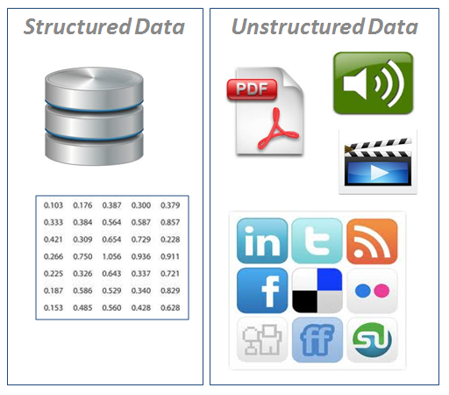

Word embeddings in portuguese for O&G
Unstructured Data
20%
80%
80% of the data are unstructured, there are valuable information dispersed in various databases.
Papers and periodicals
Technical studies
Lab analysis
Operational logs
Reports
Natural Language Process (NLP) and Deep Learning algorithms are been used to extract information of unstructured data.

Slide 3
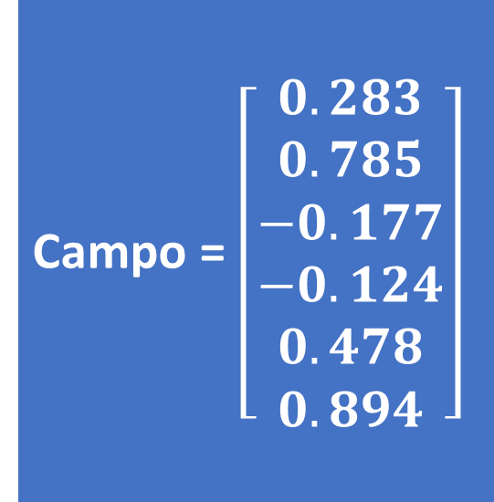
Word embeddings in portuguese for O&G
Word embeddings
How to represents text in math language?
Word Vector Representation
Each word is represented by a n-dimensional vector
This vectors can be used in several Natural Language Process (NLP) algorithms (ex: document classification, sentiment analysis, information retrieval)
The vectors are generated by a specific corpus (set of documents)
The aim of this work was generate word vectors using a set of documents of Oil & Gas in Portuguese
“You shall know a word by the company it keeps”
(J. R. Firth 1957)
Campo = $\left[\begin{aligned}0.283 \\ 0.785 \\ −0.177 \\ −0.124 \\ 0.478 \\ 0.894\end{aligned}\right]$

Slide 4
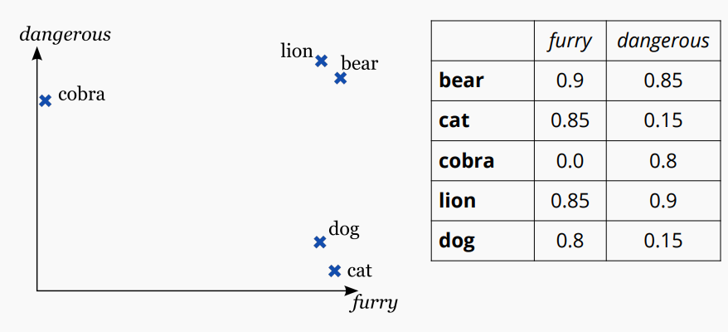
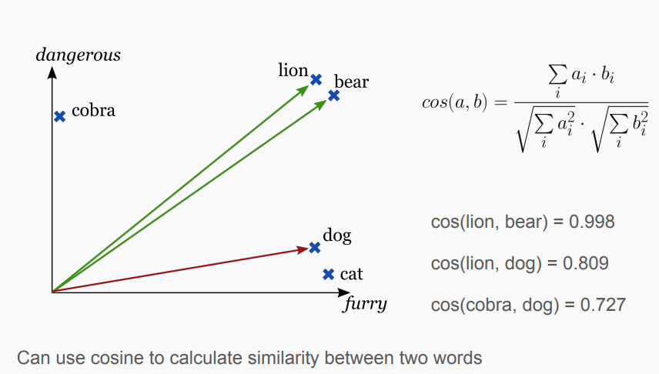
Word embeddings in portuguese for O&G
Word embeddings
Related words are near each other
Each dimension represent a different feature

Slide 5

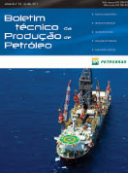


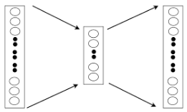
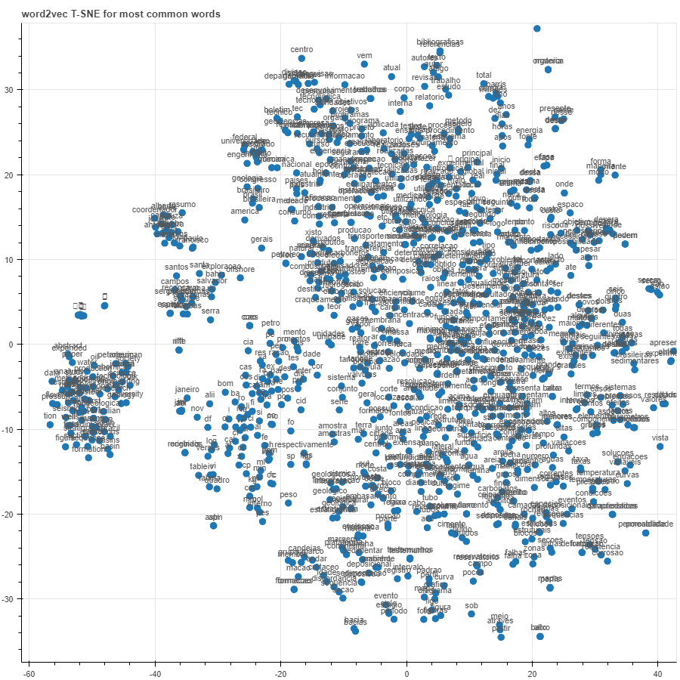

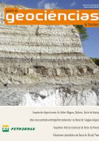
Word embeddings in portuguese for O&G
Methodology
github.com/diogosmg/wordEmbeddingsOG
Public Corpus
Preprocess the data
Apply algorithms
Word2Vec
GloVe
FastText
Visualization

Slide 6
Word embeddings in portuguese for O&G
Results - Corpus
Related words are near each other
Each dimension represent a different feature
Instituição | Base | Documents | Tokens (raw / final) | Vocabulary (raw / final)
Petrobras | Technical Bulletins | ~2000 papers | 10.229.664 / 4.962.545 | 829.907 / 86.862
Petrobras | Glossary | 562 terms | 47.470 / 30.680 | 12.215 / 7.334
ANP | Glossary | 554 terms | “ | “
Dicionário do Petróleo | Siglary | 1255 terms | “ | “
ANP | Monographs, dissertations and theses | 316 documents | 6.288.925 / 3.308.466 | 394.771 / 52.880
ANP | Publications | 168 documents | 2.415.849 / 1.138.685 | 115.345 / 18.236
ANP | Technical studies | 141 documents | 1.238.429 / 669.356 | 91.391 / 16.922
 | Total |  | 20.220.337 / 10.109.732 | 113.934

Slide 7
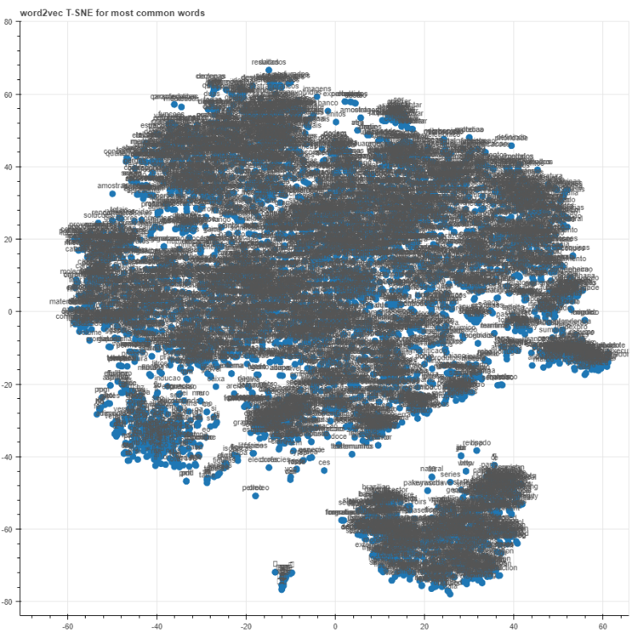
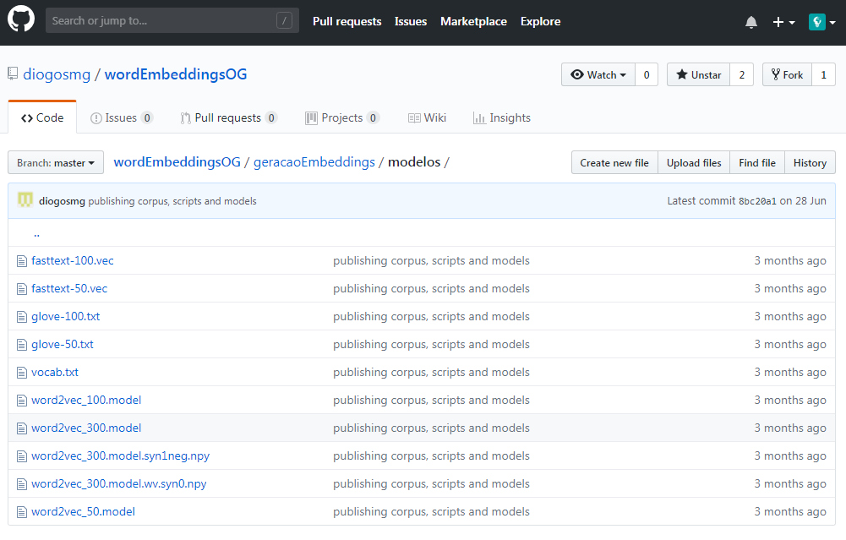
Word embeddings in portuguese for O&G
Results – Word Embeddings Models
Word embbedings models using Word2Vec, GloVe and FastText

Slide 8
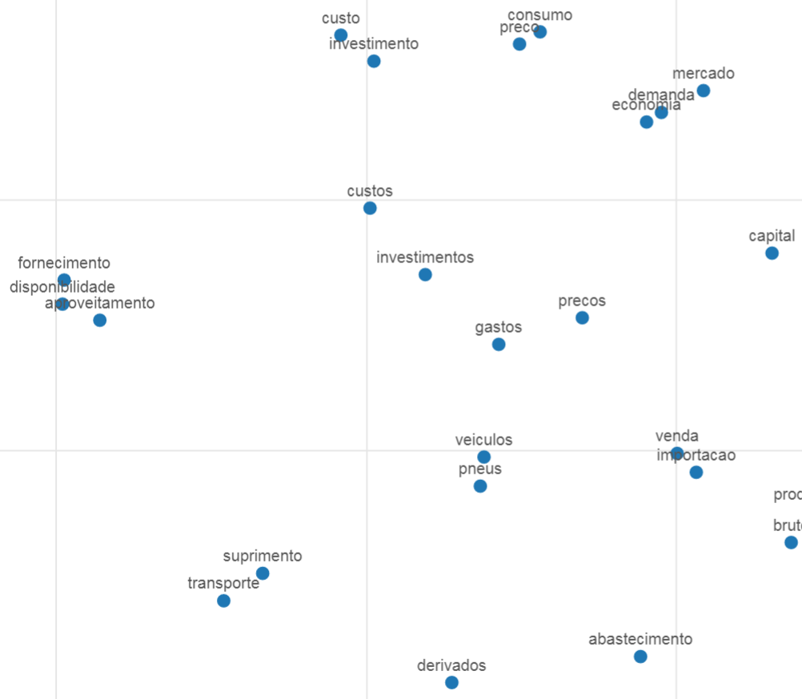
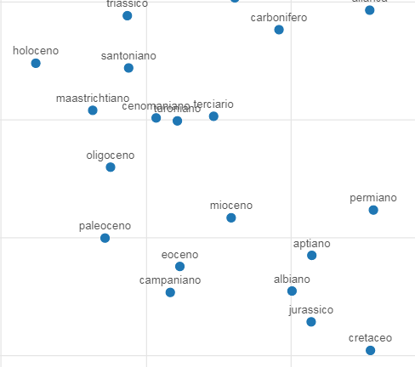
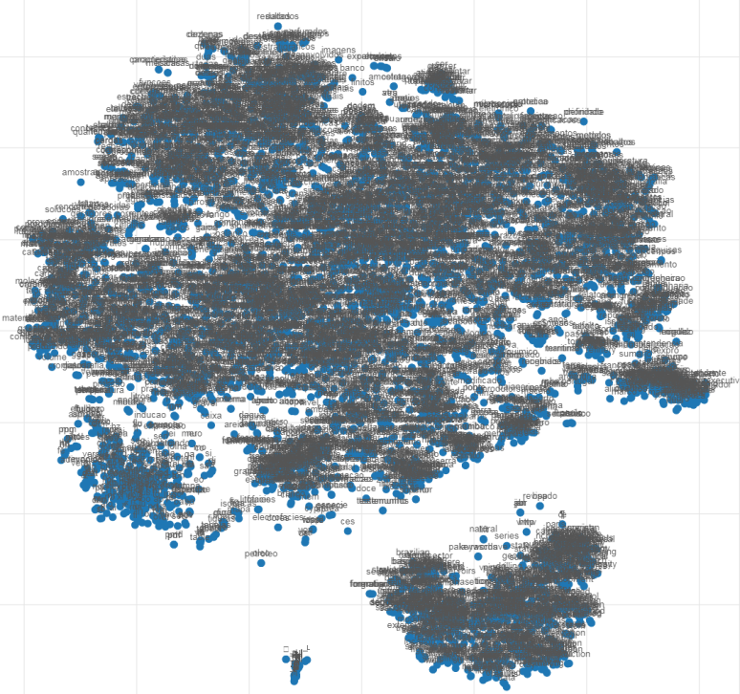
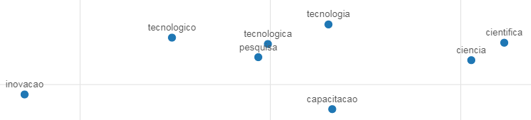
Word embeddings in portuguese for O&G
Results – Word Embeddings Visualizations
Word embbedings models using Word2Vec, GloVe and FastText
a
Idioma inglês

Slide 9
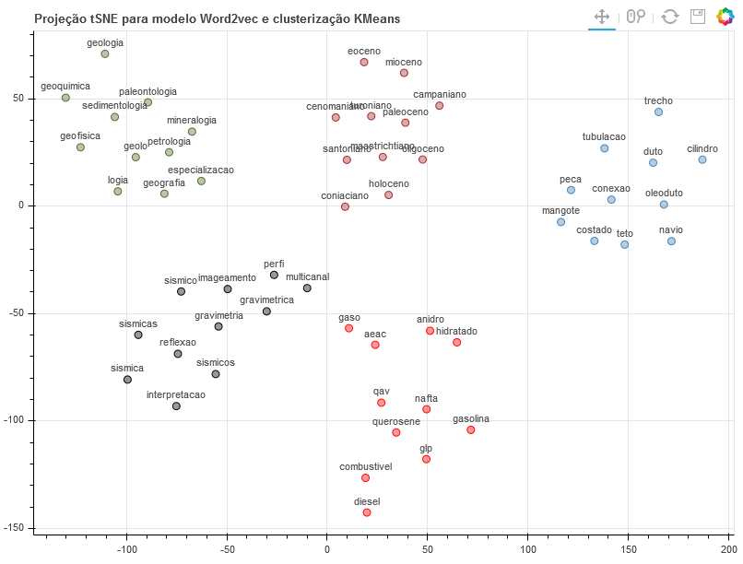
Word embeddings in portuguese for O&G
Results – Word Embeddings Visualizations
t-SNE projections to five nearest neighbors of terms:
gasolina
duto
geologia
sismica
paleoceno

Slide 10
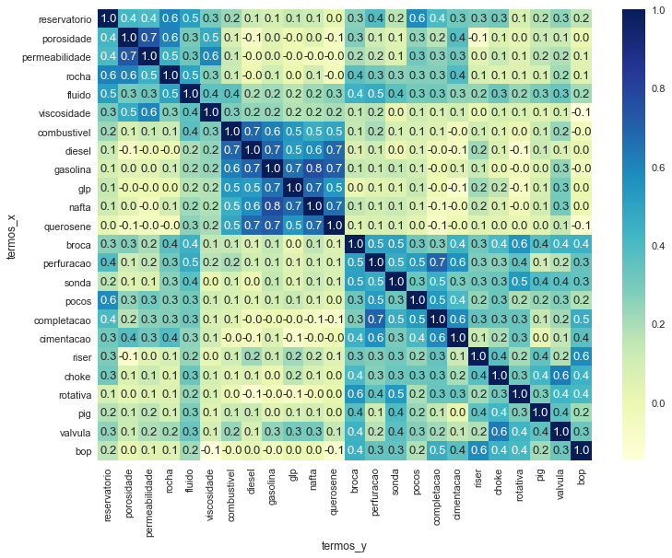
Word embeddings in portuguese for O&G
Results – Word Embeddings Visualizations
Cosine similarity between terms related the concepts:
Reservoir
Oil products
Drilling
Submarine equipment

Slide 11
Word embeddings in portuguese for O&G
Models Comparison
Termo | NILC/USP | Word2vec | FastText | GloVe
Lula | Ex-presidente, Inácio | Sapinhoa, Jubarte | Jubarte, baleia | Sapinhoa, jubarte
Campo | Estádio, gramado | Reservatorio, jazida | Oampo, alvo | Covetorial, reservatório
Rocha | Ribeiro, Alves | Porosidade, geradora | Rochamatriz, oleorocha | Porosidade, idalina
Falha | Pane, avaria | Descontinuidade, alinhamento | Falhas, falhamento | Falhas, matacatu
Duto | Tubo, aquecedor | Oleoduto, tubulação | Oleoduto, gasoduto | Trecho, diâmetro
Óleo | Sabão, alcatrão | Petroleo, vazar | Gasoleo, oleosa | Agua, diesel
Choke | Defying, remorse | Valvula, bop | Bop, stemout | Valvula, estrangulador
Árvore | Planta, trepadeira | Anm, semissubmersível | Arvoredenatal, sbm | Natal, molhada
Fadiga | Irritabilidade, sonolência | Desgaste, flexão | Trincas, trincamento | Vida, útil
BOP | Blues, funky | Descida, camisa | Chocke, blowoff | Preventer, blowout
Calado | Quieto, revez | Navio, conves | Talado, tdo | Navio, milimetros
RAO | Meir, ghozali | Pitch/ heave / roll | Arao, darão | Heave, sway

Slide 12
Word embeddings in portuguese for O&G
References
[1] Tomas Mikolov, Kai Chen, Greg Corrado, and Jeffrey Dean. Efficient estimation of word representations in vector space. ICLR Workshop, 2013. https://arxiv.org/abs/1301.3781
[2] Tomas Mikolov, Ilya Sutskever, Kai Chen, Greg Corrado, and Jeffrey Dean. 2013. Distributed representations of words and phrases and their compositionality. In Proceedings of the 26th International Conference on Neural Information Processing Systems - Volume 2 (NIPS'13). https://papers.nips.cc/paper/5021-distributed-representations-of-words-and-phrases-and-their-compositionality.pdf
[3] BOJANOWSKI, P., Grave, E., Joulin, A. Mikolov, T. Enriching Word Vectors with Subword Information. Transactions of the Association for Computational Linguistics, jun. 2017. ISSN 2307-387X. https://transacl.org/ojs/index.php/tacl/article/view/999/231
[4] Hartmann, Nathan & Fonseca, Erick & Shulby, Christopher & Treviso, Marcos & Rodrigues, Jessica & Aluisio, Sandra. (2017). Portuguese Word Embeddings: Evaluating on Word Analogies and Natural Language Tasks. Proceedings of Symposium in Information and Human Language Technology. Uberlandia, MG, 2017 Sociedade Brasileira de Computacão. http://www.aclweb.org/anthology/W/W17/W17-6615.pdf
[5] USP. Repositório de Word Embeddings do NILC. NILC - Núcleo Interinstitucional de Linguística Computacional. http://www.nilc.icmc.usp.br/embeddings
[6] Rodrigues, J., Antônio, B., Steven, N., and João, S. (2016). LX-DSemVectors: Distributional Semantics Models for Portuguese. In Computational Processing of the Portuguese Language: 12th International Conference (PROPOR-2016). Springer International Publishing.
[7] Natural Language and Speech Group of the Department of Informatics of the University of Lisbon. http://nlxgroup.di.fc.ul.pt/
[8] Stanford. CS224n: Natural Language Processing with Deep Learning, Lecture Notes – Part I, 2017. http://web.stanford.edu/class/cs224n/

Slide 13
Word embeddings in portuguese for O&G
References
[9] Facebook Open Source. FastText: Library for efficient text classification and representation learning. https://fasttext.cc/
[10] TensorFlow. Vector Representations of Words. https://www.tensorflow.org/tutorials/word2vec
[11] Wattenberg, et al., "How to Use t-SNE Effectively", Distill, 2016. http://doi.org/10.23915/distill.00002
[12] L.J.P. van der Maaten and G.E. Hinton. Visualizing High-Dimensional Data Using t-SNE. Journal of Machine Learning Research 9(Nov):2579-2605, 2008.
[13] Github. Word2vec-pt-br. https://github.com/felipeparpinelli/word2vec-pt-br
[14] S. Lai, K. Liu, S. He and J. Zhao, "How to Generate a Good Word Embedding," in IEEE Intelligent Systems, vol. 31, no. 6, pp. 5-14, Nov.-Dec. 2016. doi: 10.1109/MIS.2016.45
[15] Konstantinovskiy, Lev . Next generation of word embeddings in Gensim (palestra). https://www.youtube.com/watch?v=7530Tn2J0Mc
[16] Shihao Ji, Hyokun Yun, Pinar Yanardag, Shin Matsushima, S. V. N. Vishwanathan. "WordRank: Learning Word Embeddings via Robust Ranking", Conference on Empirical Methods in Natural Language Processing (EMNLP), Nov. 2016. https://arxiv.org/pdf/1506.02761v3.pdf
[17] Nooralahzadeh, Farhad. Cross-domain Evaluation of Word Embeddings using an Oilfield Glossary (apresentação). University of Oslo. Maio, 2017. http://www.uio.no/studier/emner/matnat/ifi/INF9880/v17/materials/nooralahzadeh.pdf
[18] Pennington, J, Socher, R., Manning, C. D. Glove: Global vectors for word representation, in Empirical Methods in Natural Language Processing (EMNLP), pp. 1532–1543.http://www.aclweb.org/anthology/D14-1162, 2014.

